Slide 1
Voriconazole Group 10: Oral Model
By: Nicole Mohajer and Jiaqi Fu

Slide 2
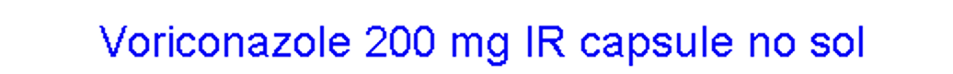
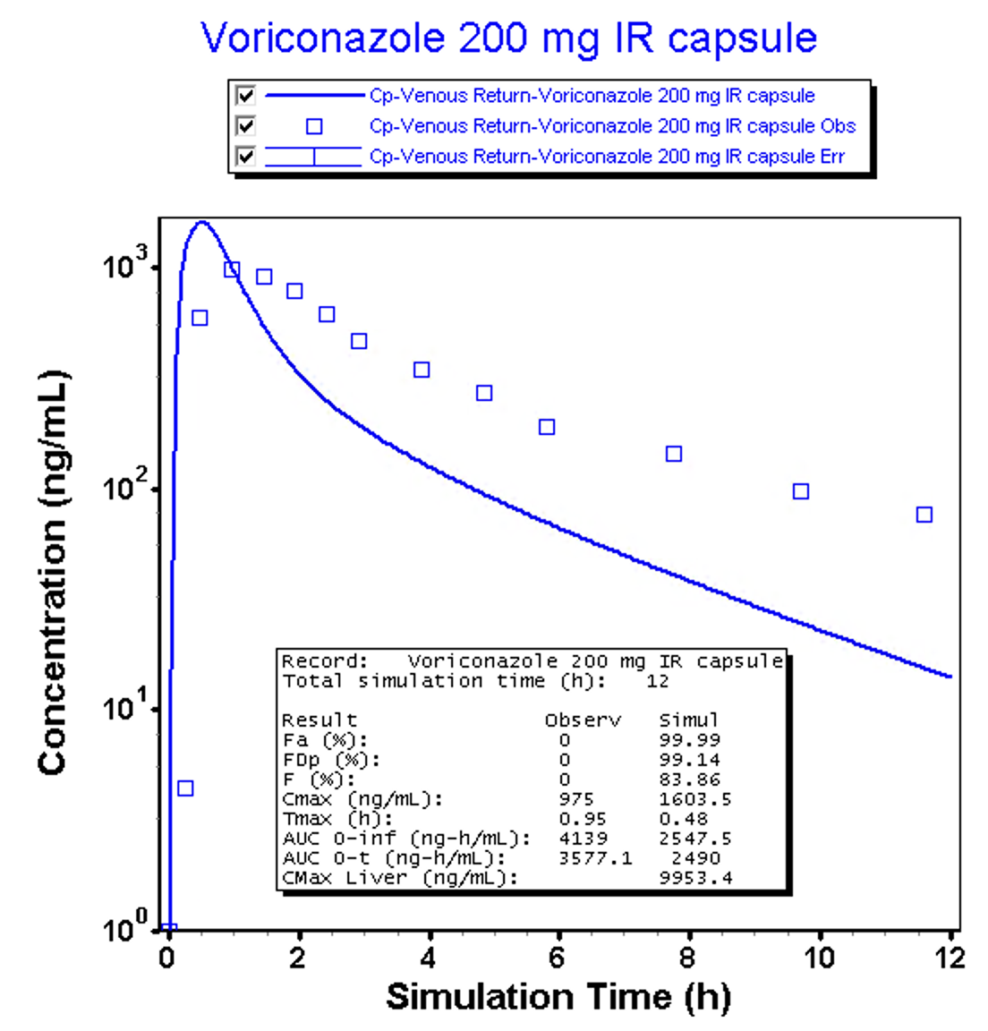
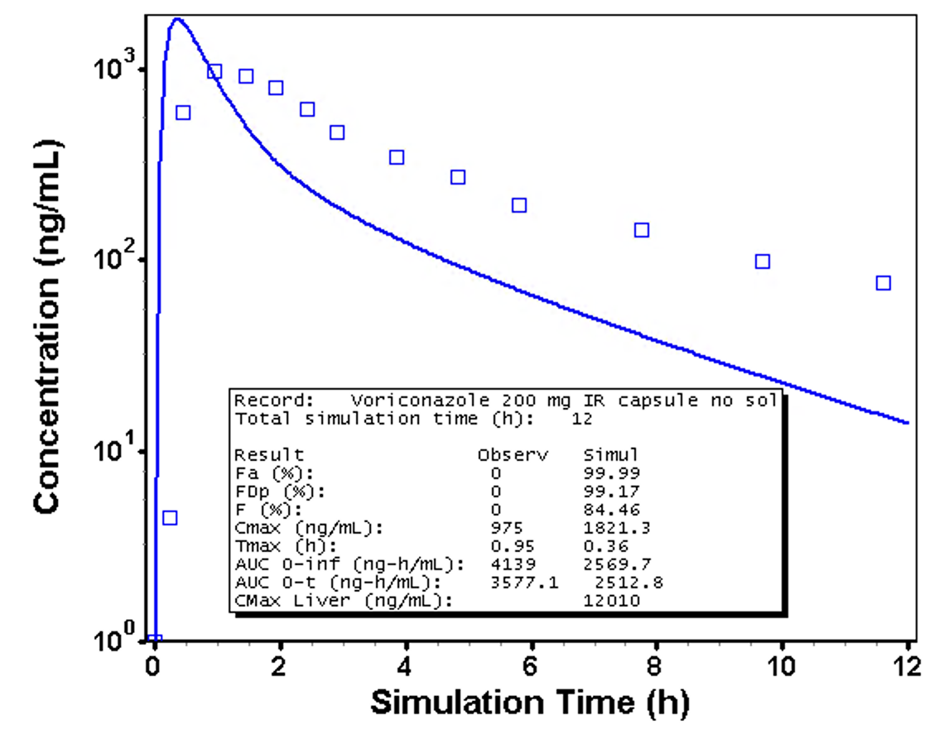
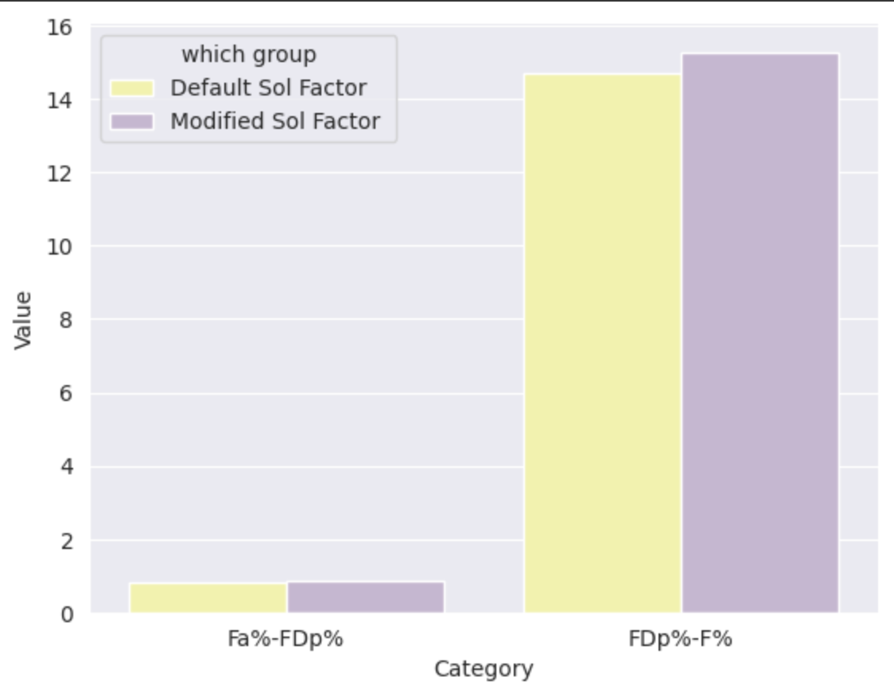
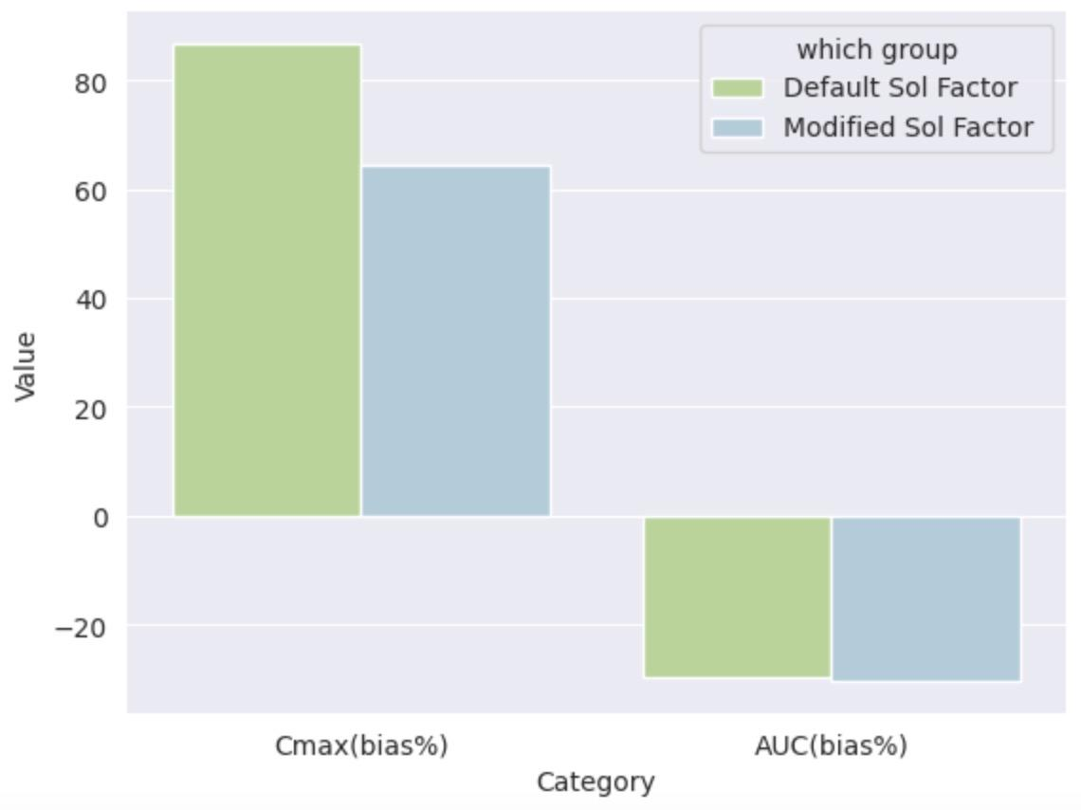
BASELINE
Voriconazole parameters:
LogP = 2.1 and pKa = 1.76 (base)
Enzyme kinetics 7x original
Takeaways:
⇒ Voriconazole is highly soluble
(Right Panel) Steps taken:
Changed solubility data
Ref sol: 0.61 mg/mL at pH 7
Sol factor: 2.7 mg/mL (pH 1.2) / 0.61 mg/mL (pH 7) = 4.42
(Left Panel) Steps taken:
Copied IV drug record
Modified dosing type/amount
Added PEAR and half CL
26 yr, 71 kg, half CL = 24.16L
Added gut enzyme kinetics
Solubility data:
a. Ref sol: 2.99 mg/mL at pH 7.55
b. Sol factor: 37.16
Next steps:
⇒ Modify enzyme kinetics to improve AUC (clearance is too high)
⇒ Change Peff
ΔFDp% and ΔFa%
ΔCmax and ΔAUC
Notes:
Baseline: The enzyme parameters data can be found at: https://docs.google.com/spreadsheets/d/1PdfvcS007rDlSsno7K-z7iPEl3Z9E5TyYlJ4Xgepr1U/edit?usp=sharing
titled-“Increase Vmax by x7 fold except for FMOs”
The Left Panel: Copied previous IV drug record and change the dosing type to “IR Capsule”, and the amount of “200mg”; Add the new PEAR physiology and half Clearance data; Add the gut enzyme parameter, as it shown in the slide 4; The solubility data is the default setting.
The Right Panel: Based on all the parameters in the left panel, modified the solubility data which is derived from the web sources, and calculated the solubility factor.
Two panels in the bottom: The left panel represents for the differences between Fa%-FDp% and FDp%-F% within two groups. The conclusion is that the change of the drug solubility will not affect the proportion of drug that is lost (e.g., through metabolism within enterocytes or by efflux transporters back into the gut lumen) before it can reach the portal circulation; however, the FDp%-F% value of the modified solubility group(4.42) is slightly higher than it of the default group(37.16), representing for a lower F%. This is because: For highly soluble drugs, a larger amount of drug reaches the enterocytes simultaneously, potentially saturating the efflux transporters or metabolic enzymes. This saturation reduces the relative proportion of drug lost through these mechanisms. In contrast, less soluble drugs release more slowly, which might prevent saturation of these systems. Consequently, a greater proportion of the drug that is absorbed may be metabolized or effluxed, leading to a higher FDp%-F% and lower bioavailability (F%). The Cmax values of two groups also can reflect such mechanism, with the high solubility group significantly higher than the low solubility group.
The next step is to optimize the enzyme parameters to reduce the clearance and also, change the value of Peff. Moreover, the dose level will be 400mg, and the new physiology will be 32yrs, and 80kg.

Slide 3
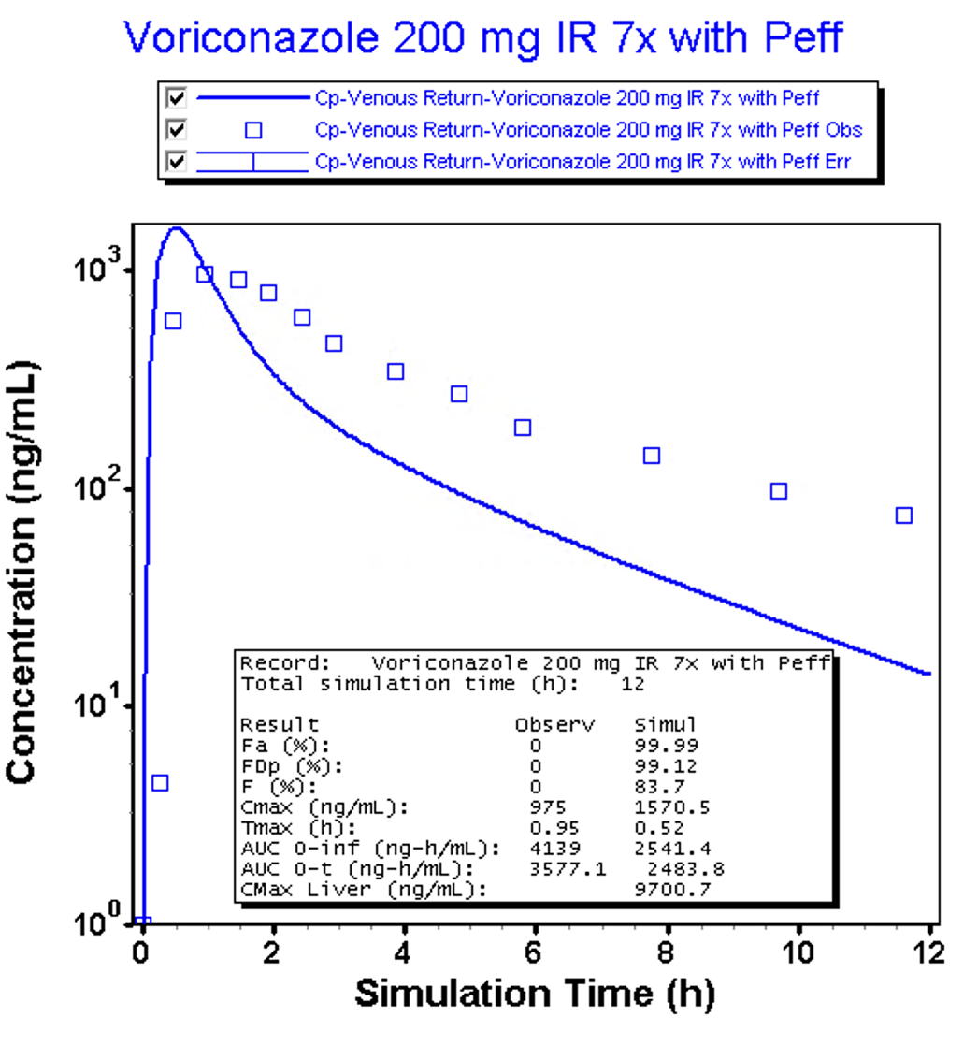
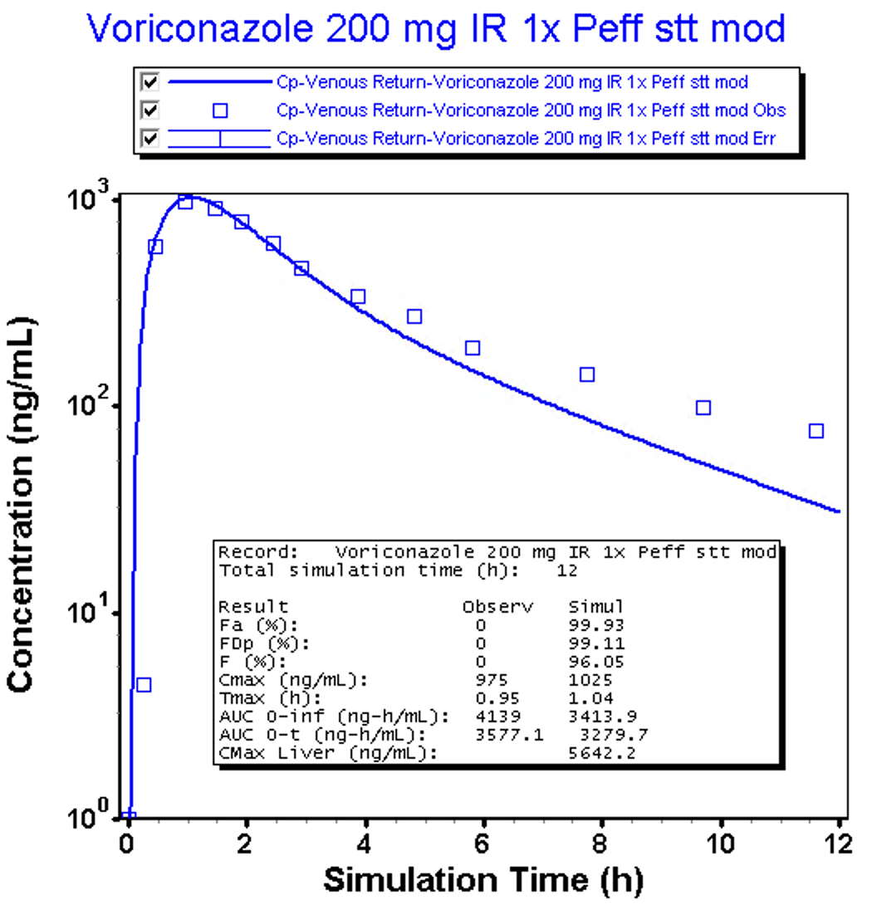
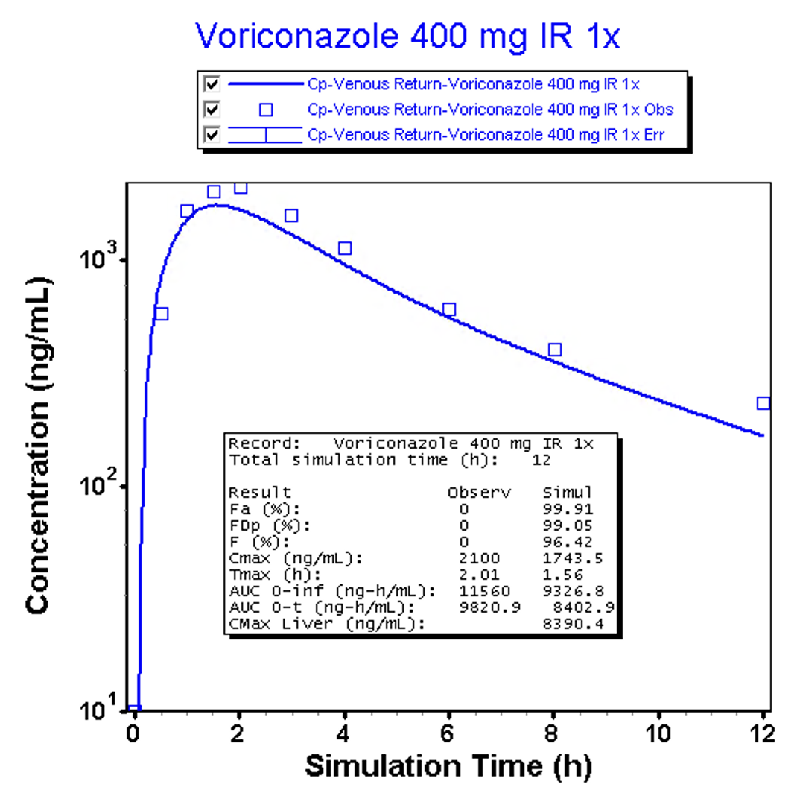
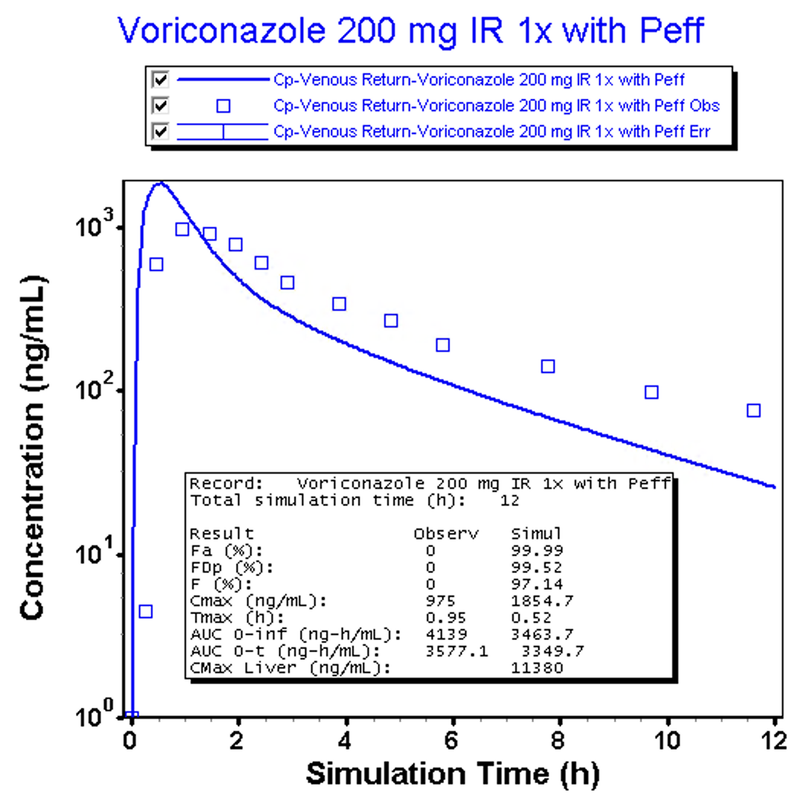
Change Peff: 4.57 x 10⁻⁴ cm/s ⇒ 4.3 x10⁻⁴ cm/s
Enzyme Vmax to 1x value improves AUC
New dose: 400 mg
PEAR: 32 yr, 80 kg
Steps taken:
Increased stomach transit time
Steps taken:
Lowered Peff
Increased stomach transit time
Improved Tmax and Cmax
Transit time: 1h
Peff: 2 x 10⁻⁴ cm/s
Next steps:
⇒ Adjust stomach transit time
(1h is too long)
Transit time: 0.5h
Peff: 2 x 10⁻⁴ cm/s

Slide 4
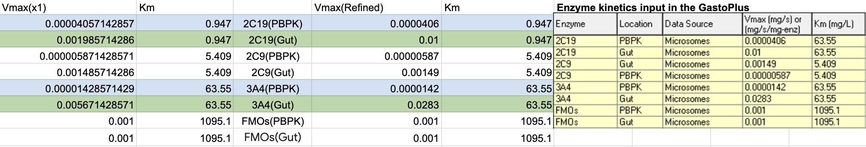
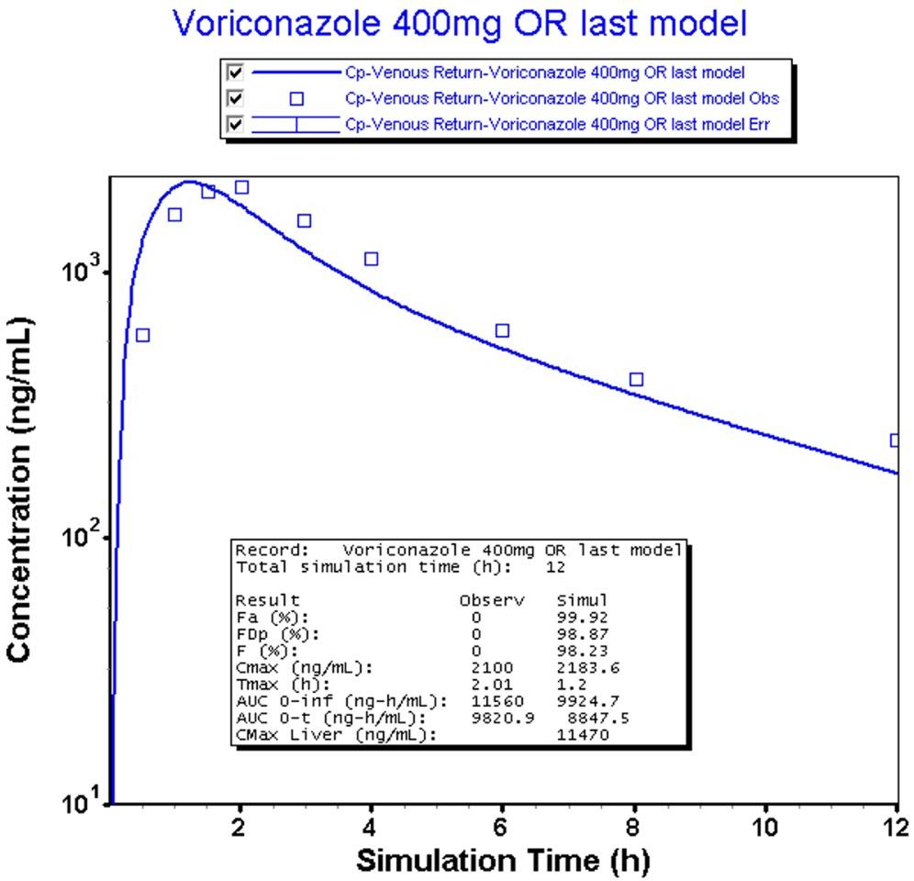
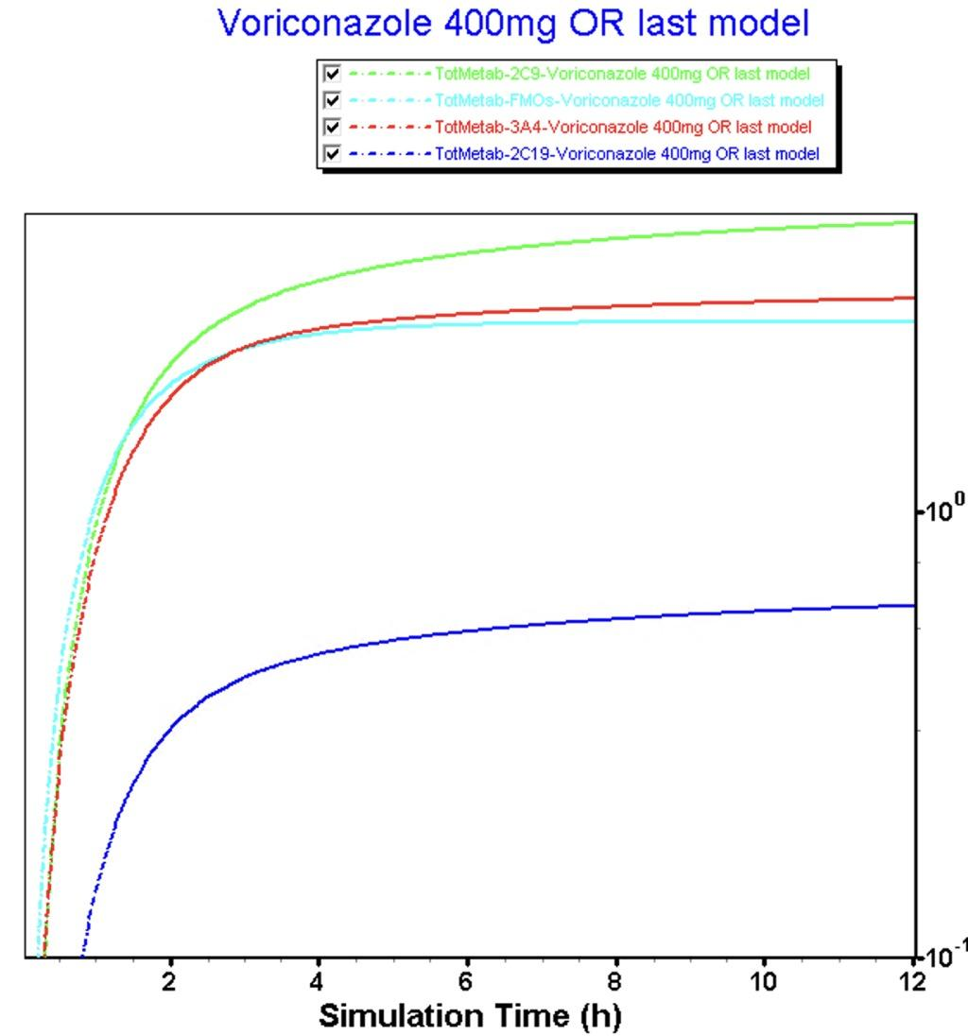
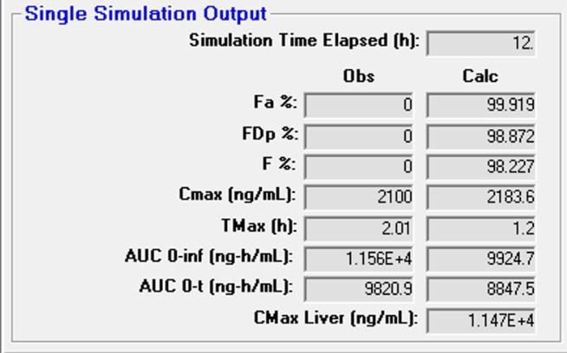
Model Refine on 400mg Voriconazole:
Increase the Vmax(x1) of CYP2C19 and CYP3A4 in the Gut(x20 fold) to increase the Tmax
Increase the Km of CYP2C19 in the liver(x35 fold) to decrease the clearance/mimic auto-inhibition
Enzyme Contribution
Settings of Vmax of enzyme(Final 400mg Oral Model Vmax and Km of enzymes) + Reference Solubility + Solubility Factor
+ New Physiology(32yrs; 80kg) + Transit time(0.5h) + Peff(2.4x10-4 cm/s)
Cmax_bias% = +3.98%
AUC_bias% = -9.91%
2C9 > 3A4~=FMO > 2C19
Auto-Inhibition of 2C19

